Slide 1
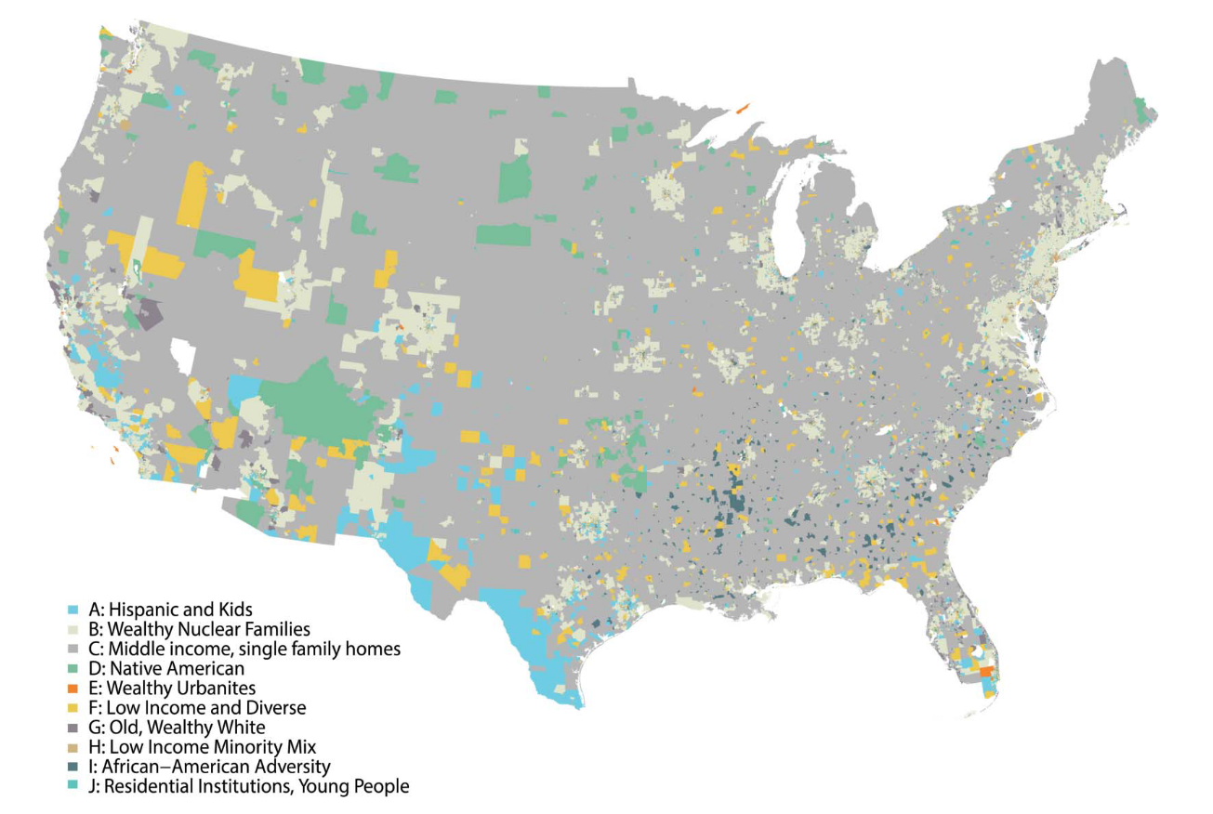




Retail and Geodemographics: A Spatial Data Science Approach
Patrick Ballantyne, University of Liverpool

Slide 2


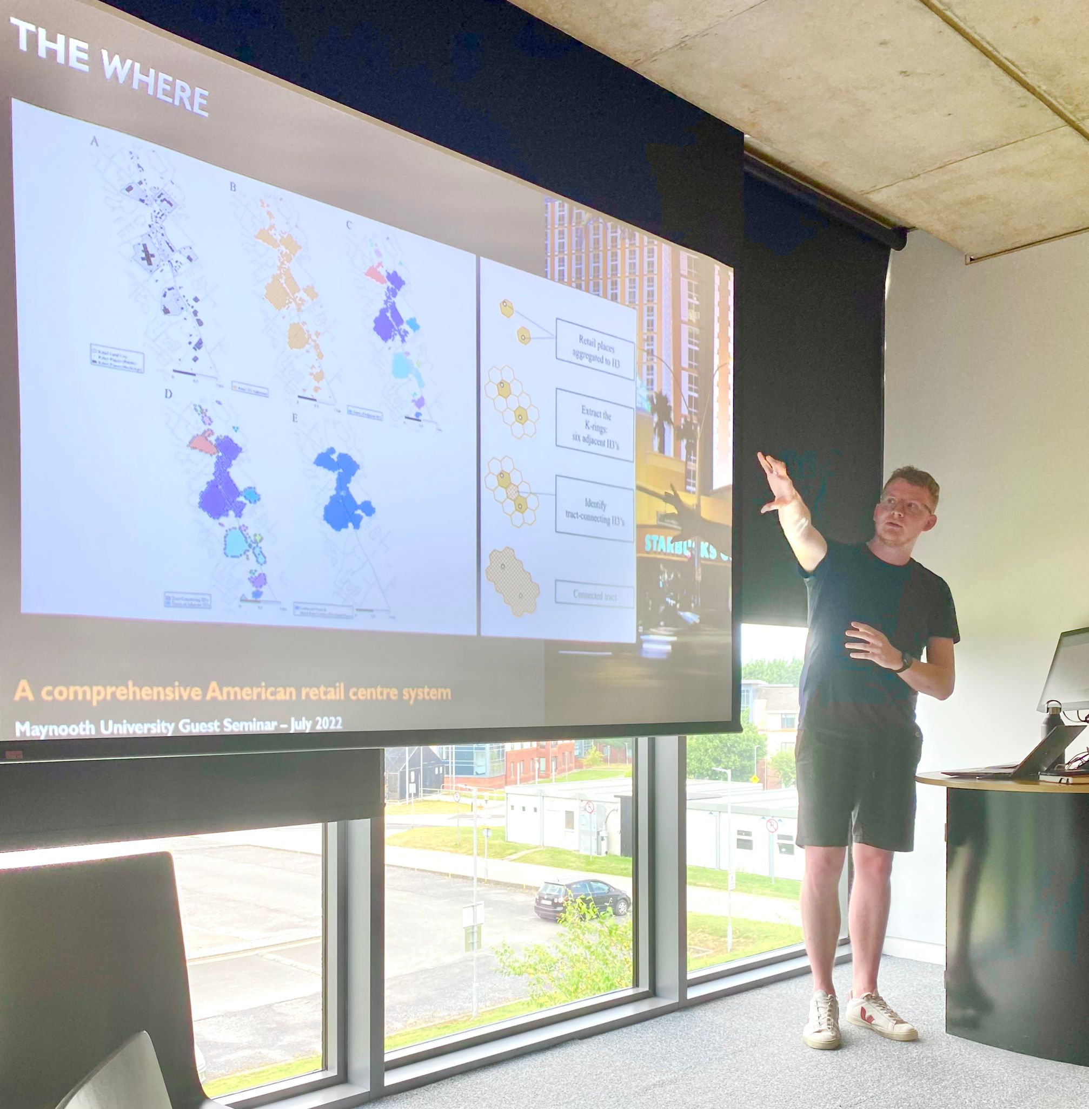

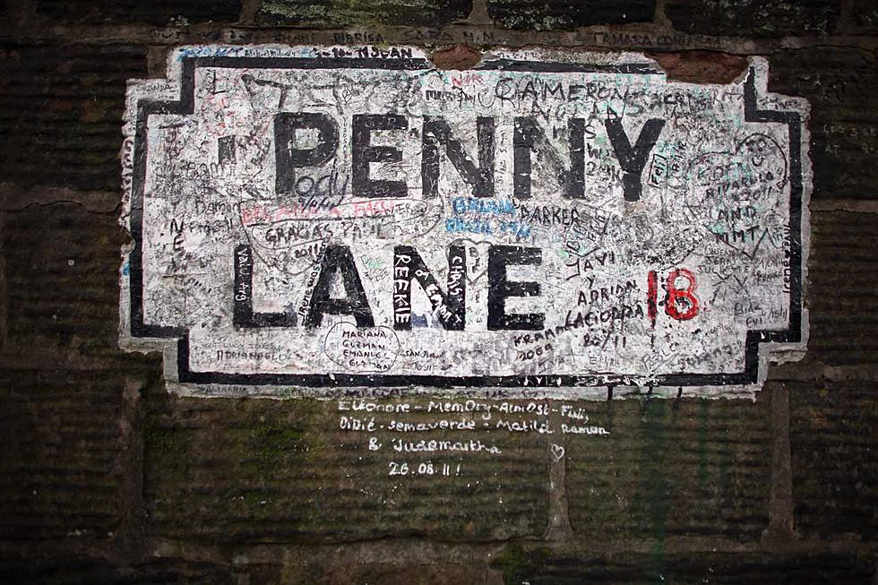


Retail and Geodemographics: A Spatial Data Science Approach
Patrick Ballantyne, University of Liverpool
Notes:
Postdoctoral Research Fellow at the University of Liverpool, UK
Come from the GDSL; group of about 50 academics and PhD students, all doing research on geographic or ‘spatial’ data science! We all work with industry partners to collaborate on projects about data and geography…
Research on lots of different things; retail and different spaces of consumption, urban mobility and mobile phone data, geodemographics

Slide 3

Retail and Geodemographics: A Spatial Data Science Approach
Patrick Ballantyne, University of Liverpool
Notes:
Postdoctoral Research Fellow at the University of Liverpool, UK
Come from the GDSL; group of about 50 academics and PhD students, all doing research on geographic or ‘spatial’ data science! We all work with industry partners to collaborate on projects about data and geography…
Research on lots of different things; retail and different spaces of consumption, urban mobility and mobile phone data, geodemographics

Slide 4
Retail and Today’s workshop : Approach
Retail and Geodemographics: A Spatial Data Science Approach
Retail store data and catchments
Geodemographics as a tool for understanding the characteristics of neighborhoods
Catchment geodemographic profiling as an approach to quickly understand the characteristics of your consumers
Notes:
Objectives of today’s workshop….
An excellent source of retail and store data for the US, ad beyond
Geodemographics, what is it? What’s available for the US?
Catchment geodemographic profiling – understanding the characteristics of your consumers and target neighbourhoods.

Slide 5

Retail and Today’s workshop : Approach
Retail and Geodemographics: A Spatial Data Science Approach
Retail store data and catchments
Geodemographics as a tool for understanding the characteristics of neighborhoods
Catchment geodemographic profiling as an approach to quickly understand the characteristics of your consumers
Notes:
Objectives of today’s workshop….
An excellent source of retail and store data for the US, ad beyond
Geodemographics, what is it? What’s available for the US?
Catchment geodemographic profiling – understanding the characteristics of your consumers and target neighbourhoods.

Slide 6
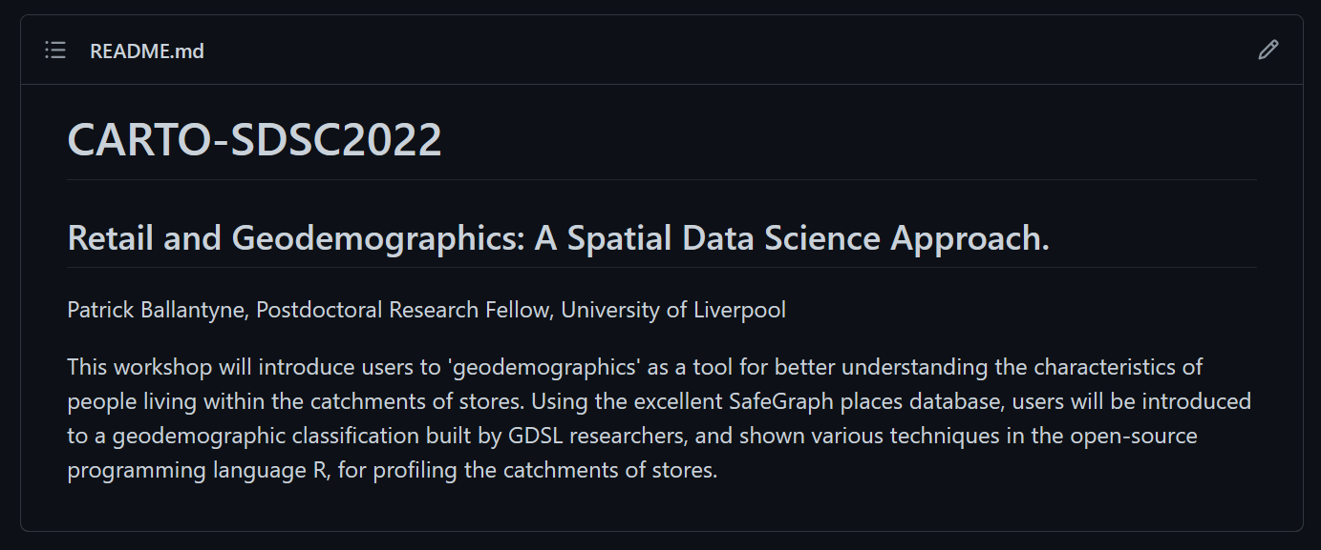

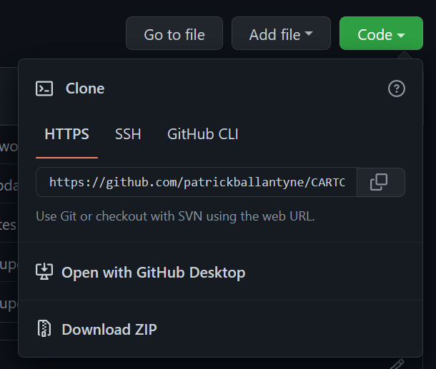
Retail and Today’s workshop : Approach
Retail and Geodemographics: A Spatial Data Science Approach
Notes:
This is the GitHub repo for the workshop today, I’ll talk a little bit more about it shortly…

Slide 7
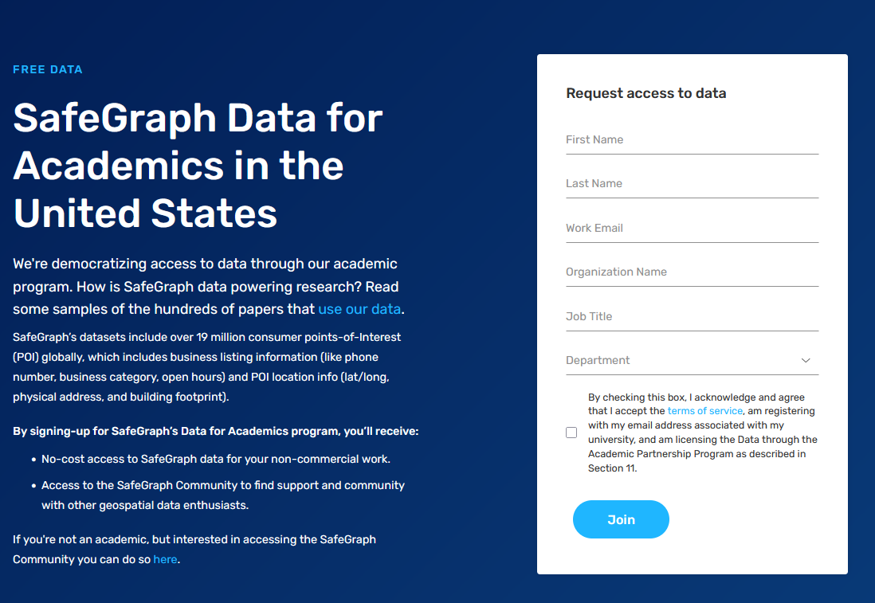

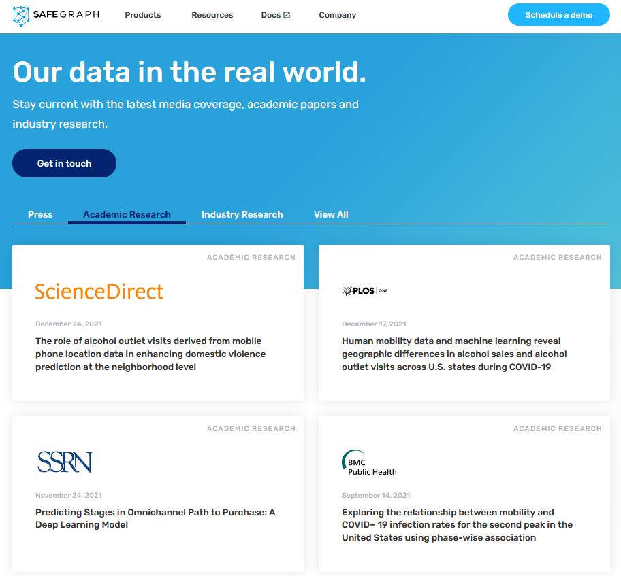

Retail and Retail : Approach
Notes:
So, I want to tell you a little story about how I came to be…
I began my PhD in 2018 (following a brief trip to the very southern tip of Ireland), with the rough title of ‘Global Retail Centres’ where the objective was to identify centres of retailing for different countries…
But I was faced with a huge challenge; how can I get access to data about retailer locations, my colleagues had finished a similar project in the UK, but the partnership with the company providing that data had evolved over many years. I did not have that time!
[CLICK]

Slide 8

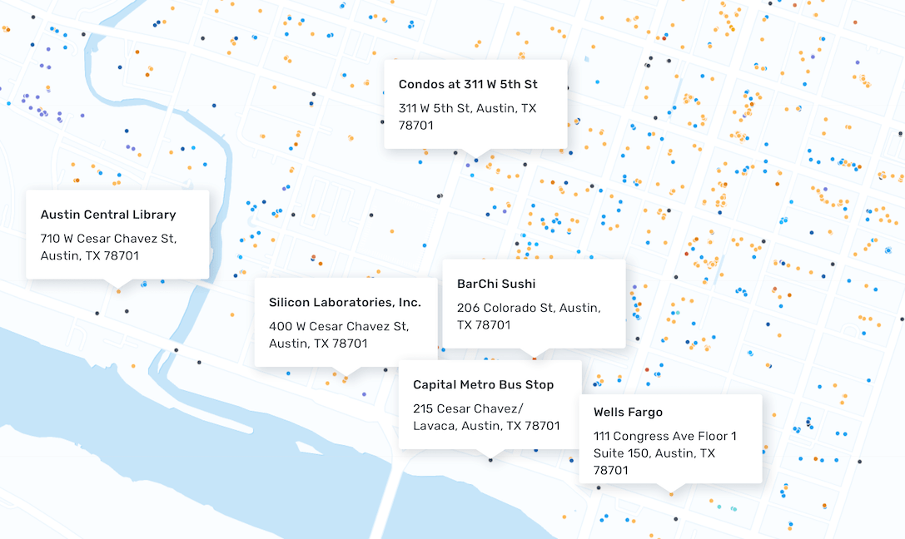
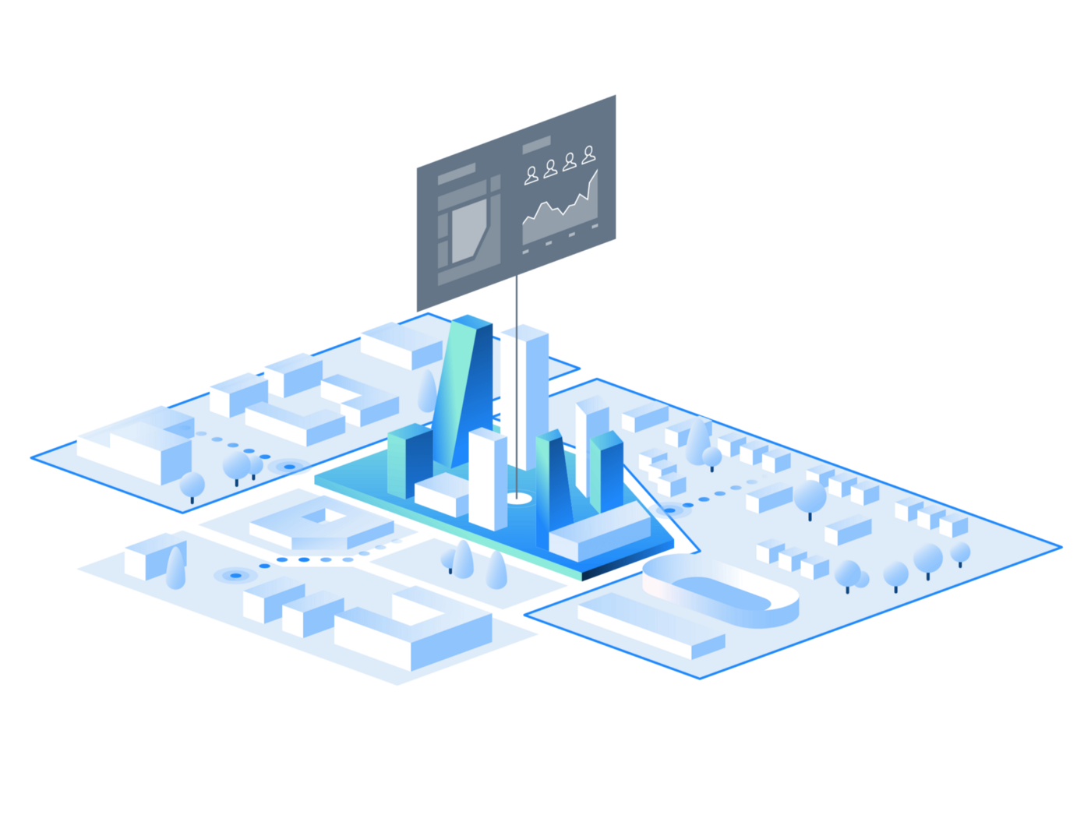
Retail and Retail : Approach
Today’s sample of the SafeGraph places for Atlanta (GA) has been kindly provided to you all by SafeGraph.
location_name | placekey | brands | top_category | sub_category
Bank of America | 222-222@8g7-3d4-tn5 | Bank of America | Depository Credit Intermediation | Commercial Banking
Bank of America | 222-222@8g6-ysq-k2k | Bank of America | Depository Credit Intermediation | Commercial Banking
Circle K | 222-222@8g7-4qd-975 | Circle K | Grocery Stores | Convenience Stores
Main Street Deli | Zzw-223@8g8-5bz-3wk | Independent | Grocery Stores | Convenience Stores
Notes:
So this is what the places dataset looks like; POIs all over the U.S.
Lot’s of attributes; we have selected a few of importance for today’s workshop
Thanks to SafeGraph you can actually play with this data now – go download it from the GitHub repository

Slide 9
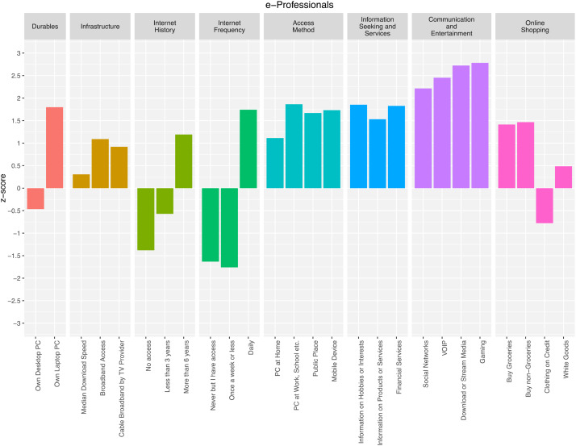
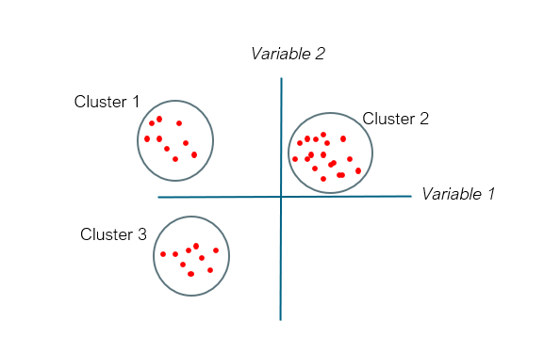
Retail and Geodemographics: A Spatial Data Science Approach
Area | Income | Age | Car | Employment | Degree | Commute
Area1
Area2
Area3
Area4
Notes:
So what is Geodemographics? It’s a method or approach to simplify the multidimensionality of neighbourhood characteristics
For example; you might have lots of different variables about areas in the US (e.g., income, age), and instead of considering these individually, you might want to consider them all together based on the assumption that different neighbourhoods will typically have similar characteristics.
Gather a series of variables about areas -> cluster analysis, groups areas together based on similar characteristics

Slide 10
Retail and Geodemographics: A Spatial Data Science Approach
https://data.cdrc.ac.uk/dataset/internet-user-classification
Notes:
This is an example of the Internet User Classification – CDRC data product, geodemographic classification that accounts for neighbourhood characteristics, with a specific focus on use of internet, online shopping etc.
Diagram on the left describes the characteristics of e-Professionals; very typical with a geodemographic

Slide 11
Notes:
However, In this workshop we wanted to introduce you to a geodemographic classification for the U.S., that can be of use to you all

Slide 12
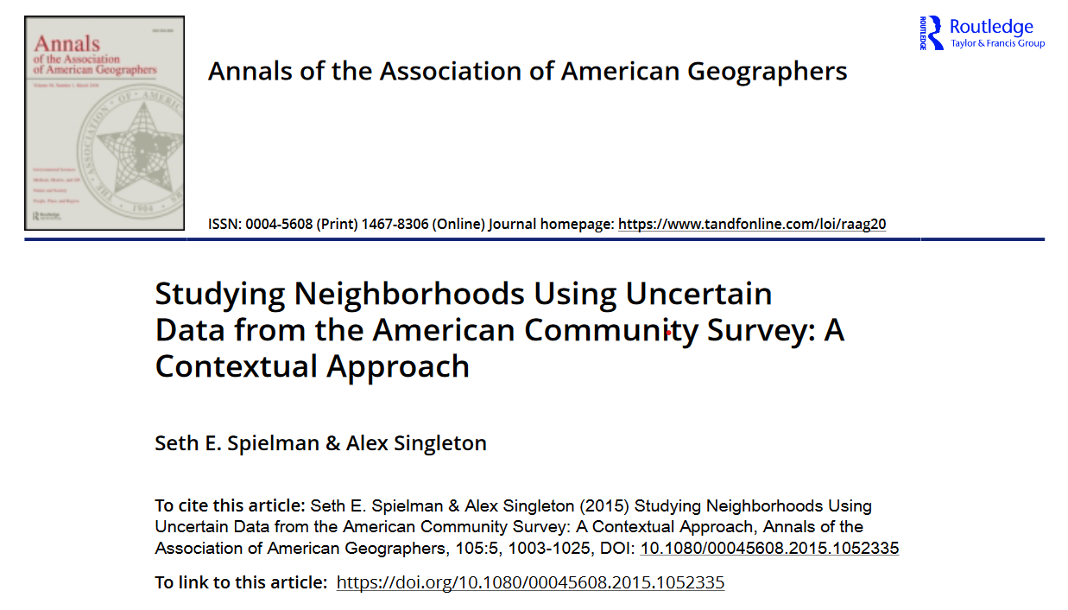
Notes:
It comes from this paper that was published a few years ago – took data from the ACS and used that to construct a geodemographic classification of neighbourhoods at the Tract level…

Slide 13
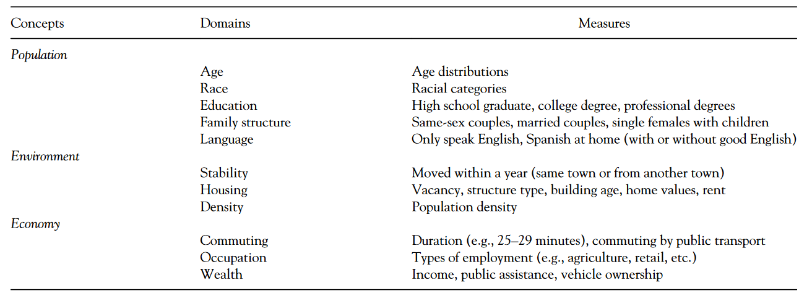
Notes:
Here are the classification domains; measures are simplified, will have been lots of different input variables used to capture each domain and multiple domains to capture each concept.

Slide 14
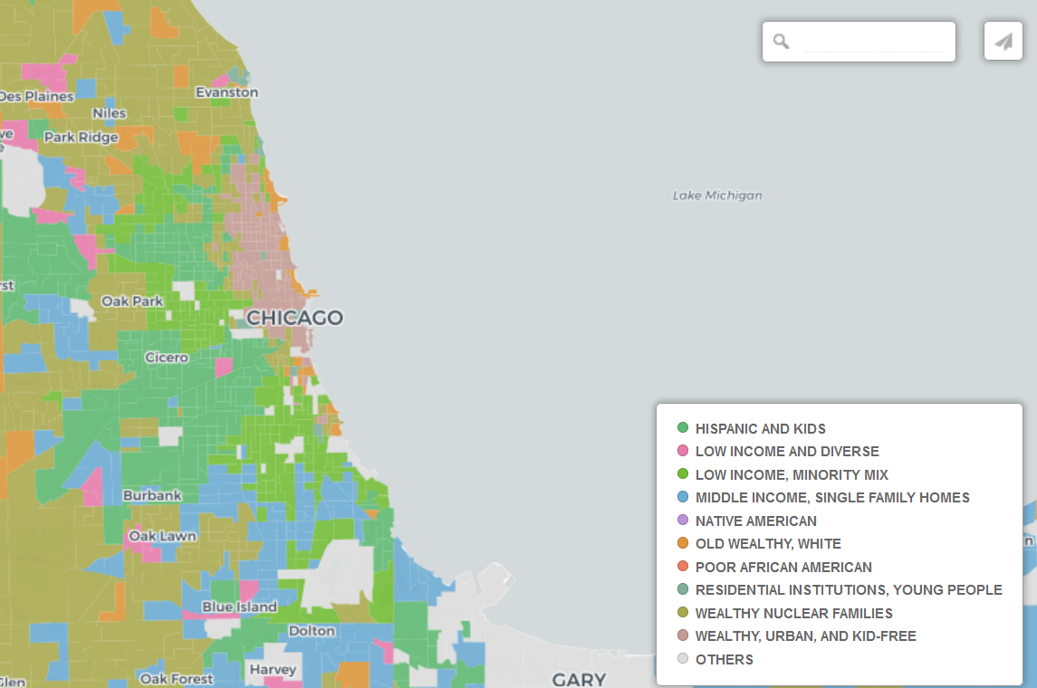

Notes:
OK! Time for you to go and explore; check out what group you are in with this interactive map…

Slide 15
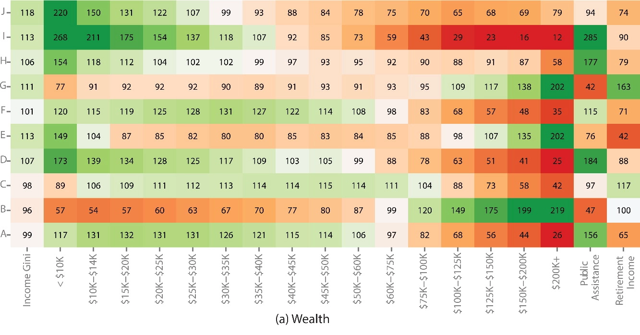
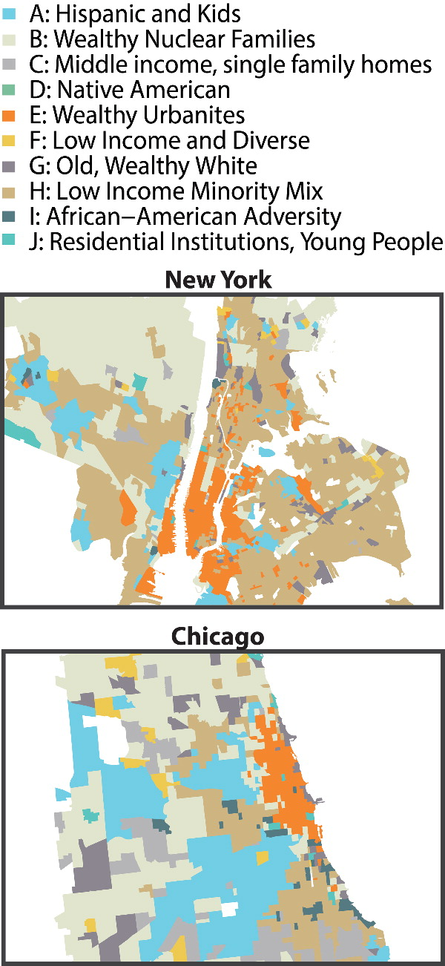
Notes:
But the map on its own is not very useful is it? We need to know a little bit more about what these groups mean…
So, let’s take E: Wealthy Urbanites which dominate in Manhattan… And look at their income profile…
Some of the riches Americans live in these groups (+ $200k)

Slide 16
Retail and Today’s workshop : Approach
Retail and Geodemographics: A Spatial Data Science Approach
Retail store data and catchments
Geodemographics as a tool for understanding the characteristics of neighborhoods
Catchment geodemographic profiling as an approach to quickly understand the characteristics of your consumers
Notes:
So just to return to the objectives of today’s workshop before we get stuck into some live coding…

Slide 17


Retail and Today’s workshop : Approach
Language, syntax, commands...
IDE: friendlier, better functionality….
Notes:
I’m going to be showing you the datasets and how you can carry out catchment (geodemographic) profiling using R, and open source language…
However, the techniques we use here would be very simple to do in a desktop GIS, other coding language like Python or I’m sure within Spatial SQL and other CARTO tools.

Slide 18
Retail and Today’s workshop : Approach
Language, syntax, commands...
IDE: friendlier, better functionality….
https://tinyurl.com/CARTO-git
Notes:
I’m going to be showing you the datasets and how you can carry out catchment (geodemographic) profiling using R, and open source language…
However, the techniques we use here would be very simple to do in a desktop GIS, other coding language like Python or I’m sure within Spatial SQL and other CARTO tools.

Slide 19
[ Demo 1 - Data ]
Notes:
So let’s take a look at a few of the datasets…

Slide 20
How to link Retail store data and neighborhood characteristics (Geodemographics)? Approach

Slide 21
Retail and Store Catchments : Approach
Understanding your customers:
WHO they are
WHAT characteristics they share
WHERE they come from

Slide 22
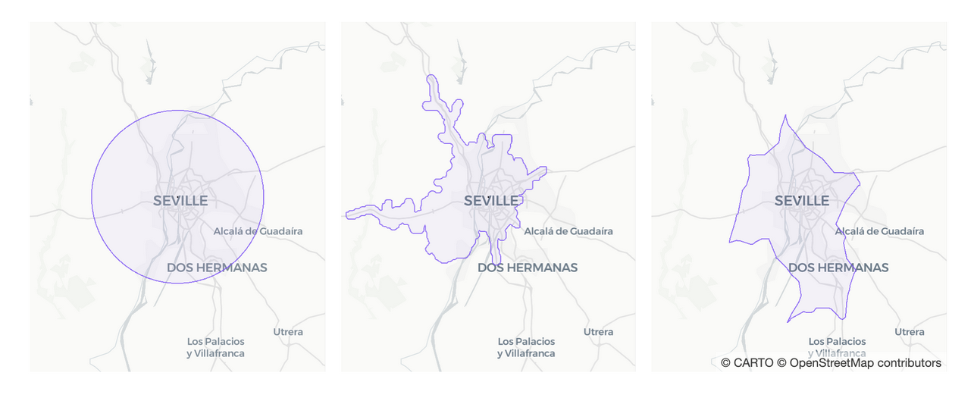
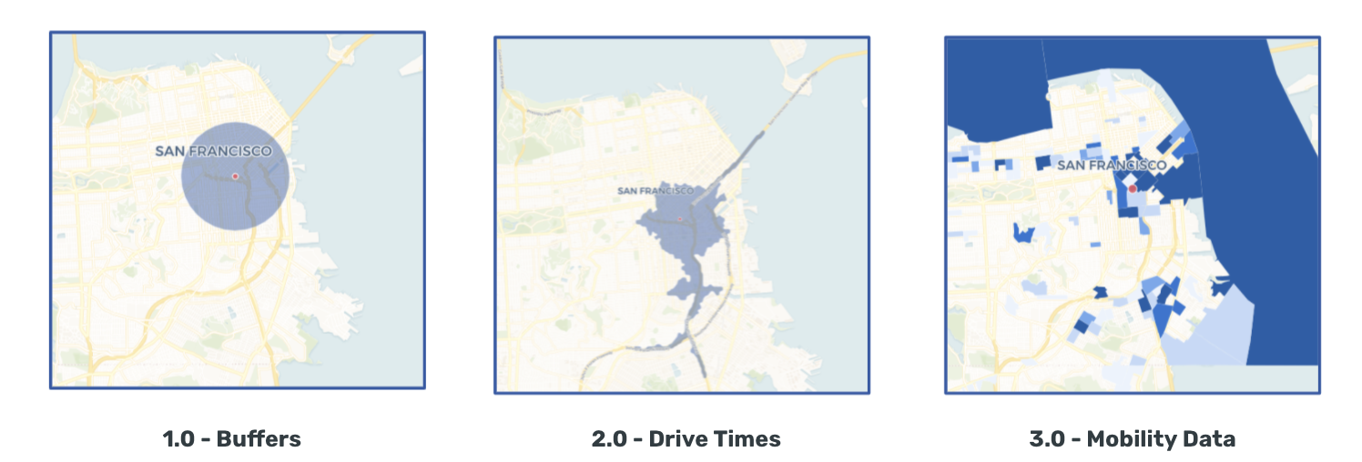
Retail and Store Catchments : Approach
Understanding your customers:
WHO they are
WHAT characteristics they share
WHERE they come from
HOW?
Source: CARTO
Source: SafeGraph

Slide 23
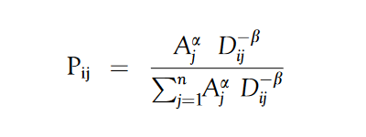
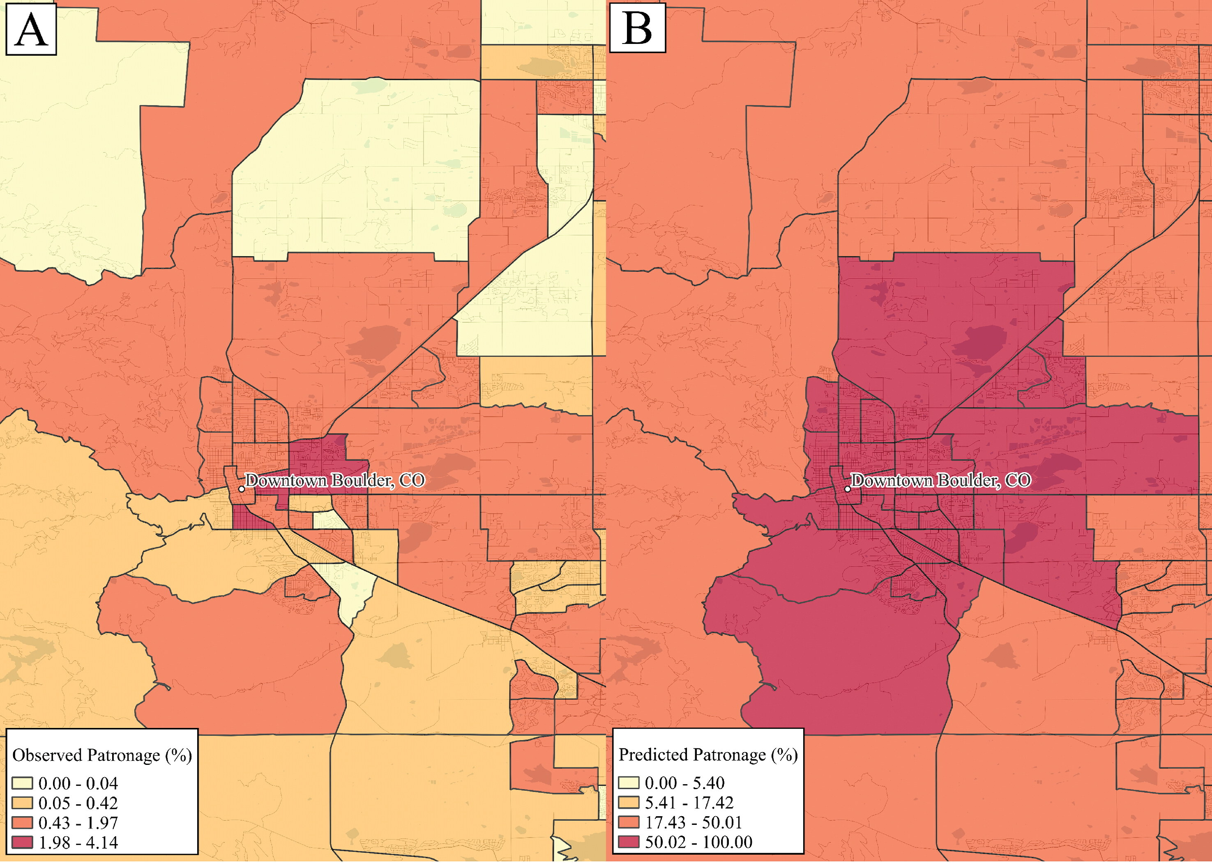
Retail and Store Catchments : Approach
Understanding your customers:
WHO they are
WHAT characteristics they share
WHERE they come from
HOW?
Ballantyne et al. (2022) Integrating the who, what and where of American retail centre agglomerations. Annals of the American Association of Geographers.

Slide 24
[ Demo 2 - Catchments ]

Slide 25
How to link Retail store data and Geodemographics with Catchments? Approach

Slide 26
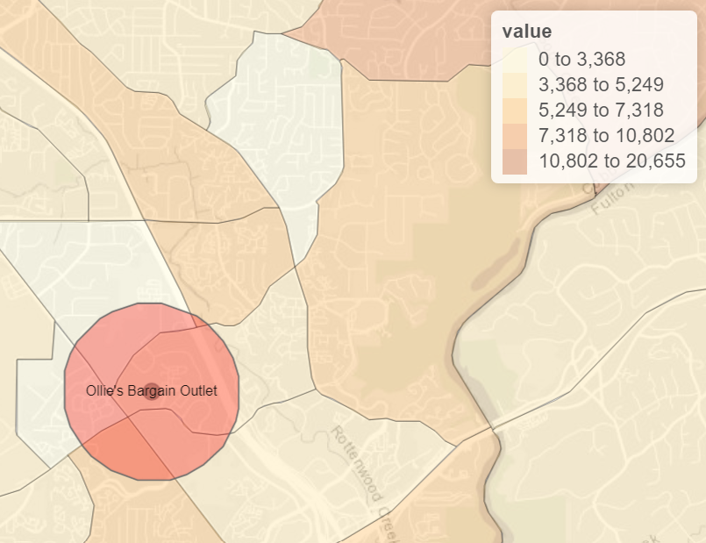
Catchment Profiling Approach
location_name | TotalPopulation
Ollie's Bargain Outlet | 24027

Slide 27
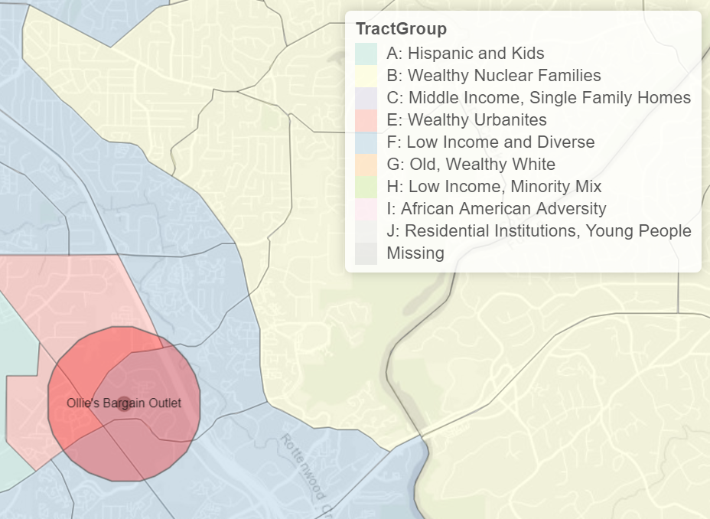
Catchment Geodemographic Profiling Approach
location_name | TractGroup | TotalTractPopulation | TotalPopulation
Ollie's Bargain Outlet | E: Wealthy Urbanites | 3810 | 24027
 | F: Low Income and Diverse | 20217 | 24027

Slide 28
Catchment Geodemographic Profiling Approach
TractGroup | z-score
A: Hispanic and Kids | -0.5
B: Wealthy Nuclear Families | 1
C: Middle Income, Single Family Homes | 0.5
E: Wealthy Urbanites | 1
F: Low Income and Diverse | -0.5
G: Old, Wealthy White | 0.5
H: Low Income, Minority Mix | -0.5
I: African American Adversity | -1
J: Residential Institutions, Young People | -0.5
location_name | TractGroup | TotalTractPopulation | TotalPopulation
Ollie's Bargain Outlet | E: Wealthy Urbanites | 3810 | 24027
 | F: Low Income and Diverse | 20217 | 24027

Slide 29


Catchment Geodemographic Profiling
Ollie’s Bargain Outlet vs Whole Foods Market? Approach
TractGroup | z-score
A: Hispanic and Kids | -0.5
B: Wealthy Nuclear Families | 1
C: Middle Income, Single Family Homes | 0.5
E: Wealthy Urbanites | 1
F: Low Income and Diverse | -0.5
G: Old, Wealthy White | 0.5
H: Low Income, Minority Mix | -0.5
I: African American Adversity | -1
J: Residential Institutions, Young People | -0.5
location_name | TractGroup | TotalTractPopulation | TotalPopulation
Ollie's Bargain Outlet | E: Wealthy Urbanites | 3810 | 24027
 | F: Low Income and Diverse | 20217 | 24027

Slide 30
[ Demo 3 – Catchment Profiling ]

Slide 31
Retail and Today’s workshop : Approach
Retail and Geodemographics: A Spatial Data Science Approach
Retail store data and catchments
Geodemographics as a tool for understanding the characteristics of neighborhoods
Catchment geodemographic profiling as an approach to quickly understand the characteristics of your consumers

Slide 32

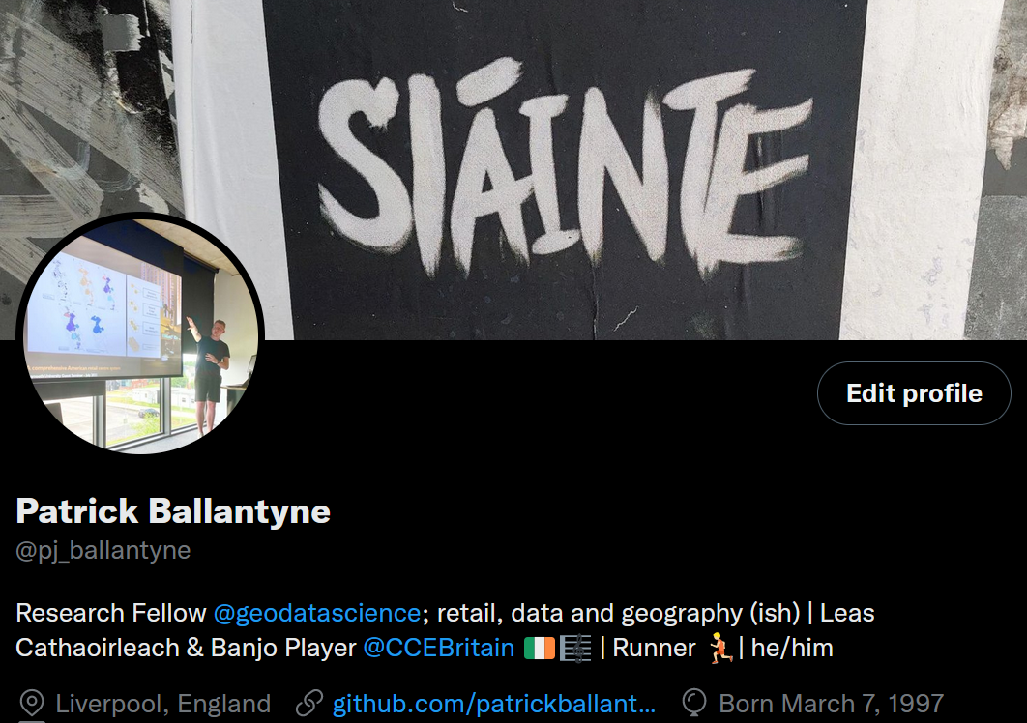
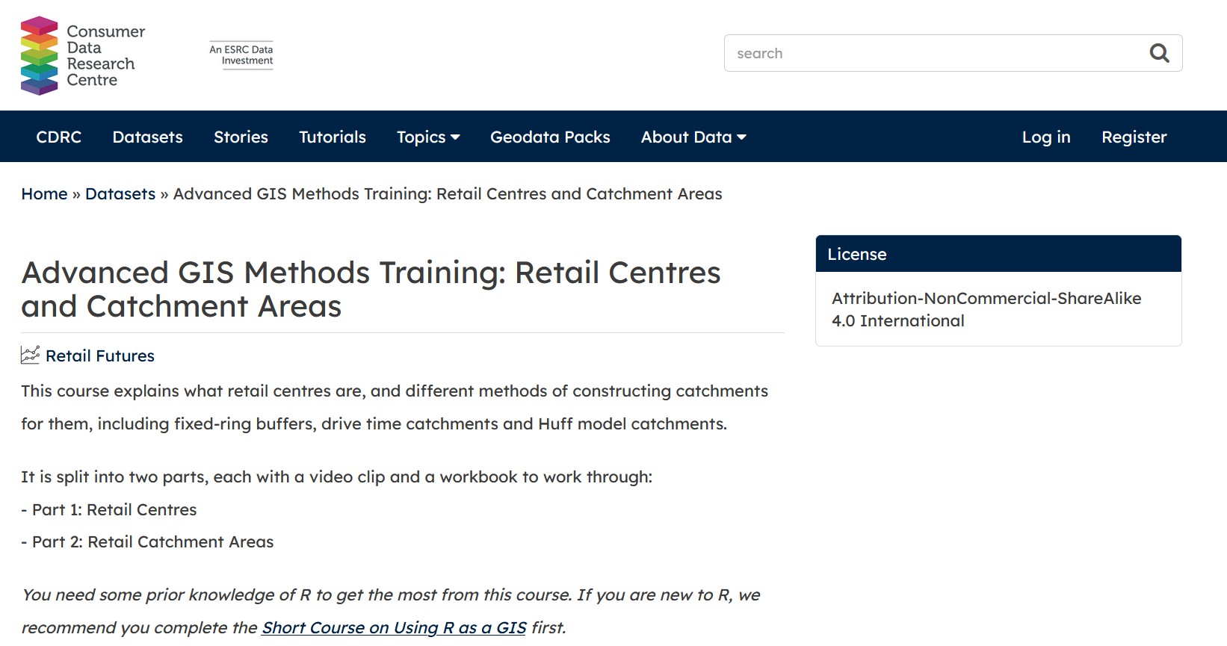
Retail and Geodemographics: A Spatial Data Science Approach
Enjoyed the workshop? Come say hi!
P.Ballantyne@liverpool.ac.uk

